Slide 1
National Systematic Observation System
for Coastal Zones of Egypt
Ibrahim Elshinnawy
CoRI Director
ClimaSouth Workshop, Cairo, Egypt 5-9 Januwary, 2014

Slide 2
outlines
Why the observation system
Coastal Data and Observation Resources
Facilities of CoRI
Coastal Observation Instruments
Data Requirements and Strategic Monitoring
Way Forward

Slide 3
Why systematic observation system
Importance of the coastal zones in Egypt:
The Egyptian coastline, including the Sinai peninsula, extends to 3,500 kilometers.
The wetlands of the Nile delta constitutes about 25% of the total wetlands area in the Mediterranean region, and produce 60% of fish catch of Egypt
The coastal zones of the Red sea incorporate about one third of the national tourist income through its illustrious cities and nature

Slide 4
Why systematic observation system
Agriculture is quite critical to the national economy
Major urban centers, commerce, and industrial activities are also confined to the Nile and the coast around its delta

Slide 5
Why systematic observation system
The coastal zone of Egypt suffers from a number of problems, including :
  high rate of population growth
  Subsidence
  excessive erosion rates
  water logging
  soil salinity
  land use interference
  ecosystem pollution and degradation
  lack of appropriate institutional management systems
  lack of consistent information system, Metrological and Oceanographic measurements

Slide 6
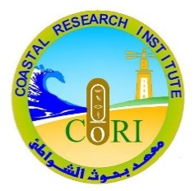
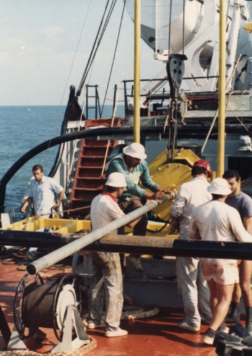
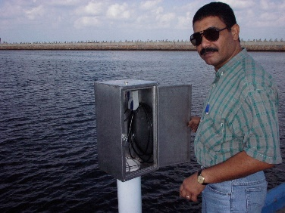
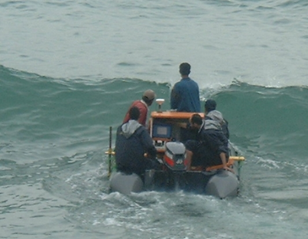
Coastal Data and Information Resources
Coastal Research Institute (CoRI)
  Responsibility:
    Protection and management Studies for shoreline and coastal systems of Egypt
    Accurate measurements and analysis of data for Egyptian coastal zones and coastal systems.
  Data Available:
    CoRI has a coastal database includes metrological, hydrological and hydrographic data since 1971

Slide 7

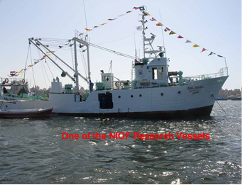
Coastal Data and Information Resources
Egyptian National Oceanographic Data Center (ENODC)
  Responsibility:
    Receive, Prepare and maintain data observed by NIOF-branches as well as the available oceanographic and weather data from Meteorological Agency, Fisheries Agency, Universities and other organization in Egypt.
  Data Available:
    Checklist of Egyptian Mediterranean and Red Sea Fishes.
    Tides at Alexandria, Egypt, for the period 1993-2000.
    Hydrographic studies of some lagoons near Hurgadda.
    Current System Survey at Exploratory drilling site Hurgada-Red Sea.
    Topography, tides and physio-chemical characteristics of Sinai.
    Concentrations of the major ions in sea water of deferent salinity.
    Physical Oceanography data for Red Sea (1990-2000).
    Circulation models applied on the eastern Mediterranean Sea.
    A comprehensive bibliography of the physical oceanography of the Mediterranean Sea.

Slide 8

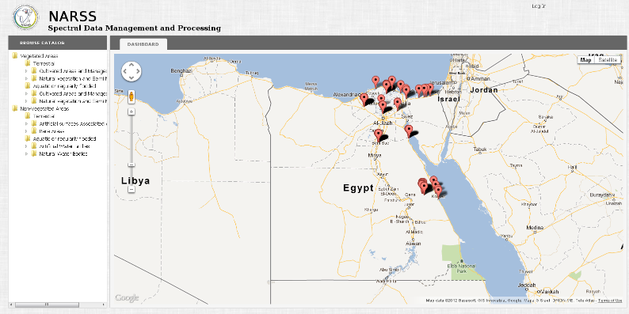
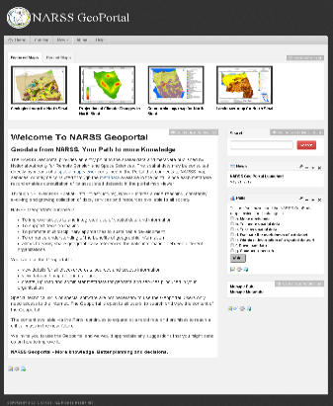
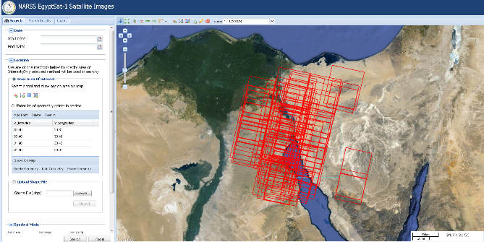
Coastal Data and Information Resources
National Authority for Remote Sensing and Space sciences (NARSS)
  Responsibility:
    NARSS is mainly aiming at promoting the use of the state of the art of space technology and Earth observation for the sustainable development of Egypt and introducing high technological capabilities into the local and regional market.
  Data Available:
    Data provided by earth observation satellites and various airborne sensors
    Produce maps and spatial data for the evaluation and monitoring of natural resources and natural hazards.

Slide 9


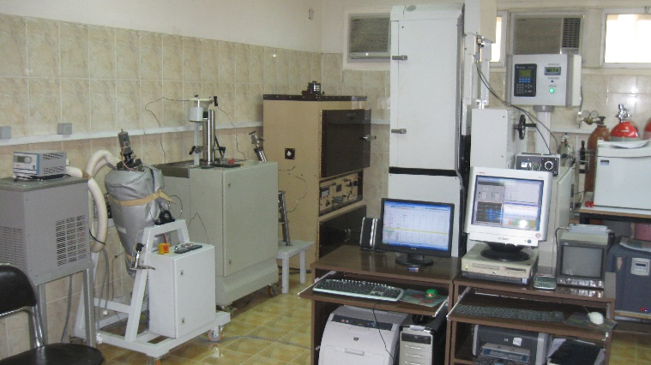
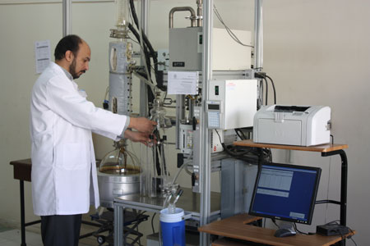
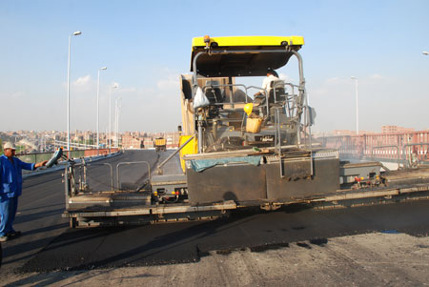
Coastal Data and Information Resources
Ministry of petroleum and Egyptian Petroleum Research Institute (EPRI)
  Responsibility:
    Develop studies and applications within the Oil sector, and to find solutions to both long and short terms Oil sector’s technical problems.
  Data Available:
    Metrological and oceanographic data of the Mediterranean and Red sea petroleum platform’s sites.

Slide 10

Coastal Data and Information Resources
Egyptian Environmental Affair Agency (EEAA)
  Responsibility:
    Formulating environmental policies.
    Preparing the necessary plans for Environmental protection and Environmental development projects, following up their implementation, and undertaking Pilot Projects.
    The Agency is the National Authority in charge of promoting environmental relations between Egypt and other States, as well as Regional and International Organizations.
  Data Available:
    Monitoring Program (EIMP) aims at establishing national environmental monitoring program for ambient air and coastal waters. (http://www.eeaa.gov.eg/arabic/main/achivements.asp)
    EEAA is responsible for collecting the EIA studies for all new projects within the coastal zone. These studies have value metrological and oceanographic data.

Slide 11

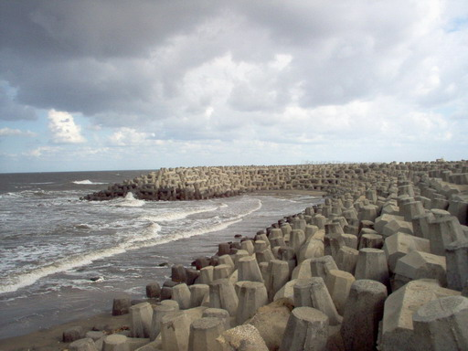
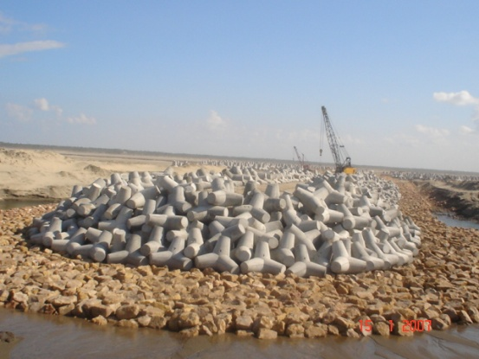
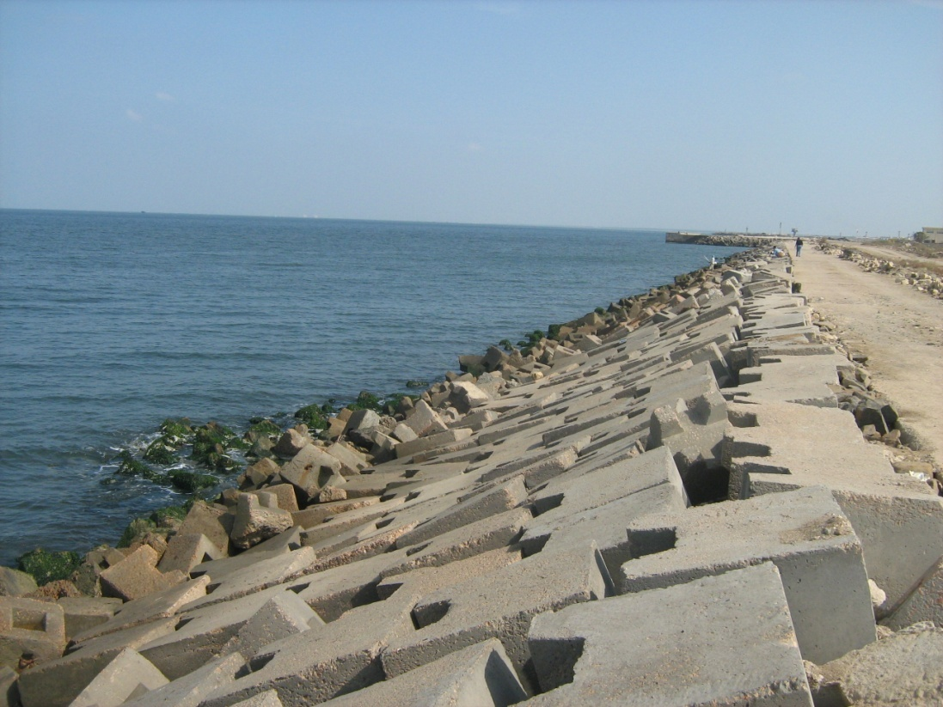
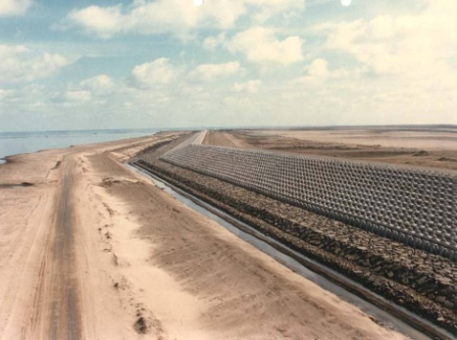
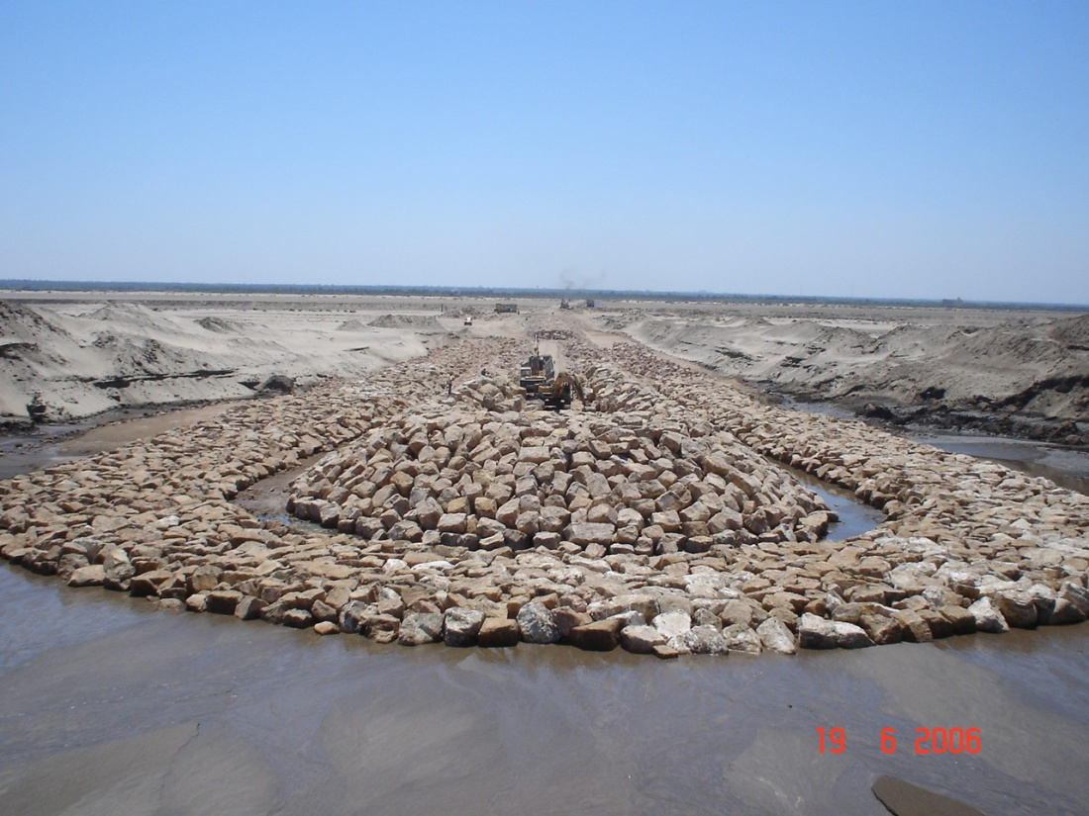
Coastal Data and Information Resources
Shore Protection Authority (SPA)
  Responsibility:
    Responsible for managing the shoreline in coastal areas that are threatened by erosion.
    Developing shorelines management plans
    Designs projects for shore protection.
    Issues license for projects to be located in the set-back area according to existing laws and regulations.
  Data Available:
    SPA has a monitoring program during construction and assessment of the coastal structures.

Slide 12

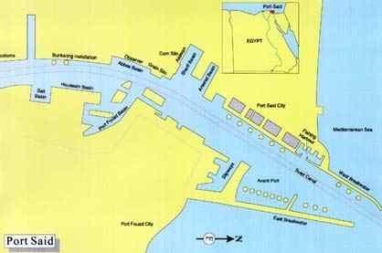
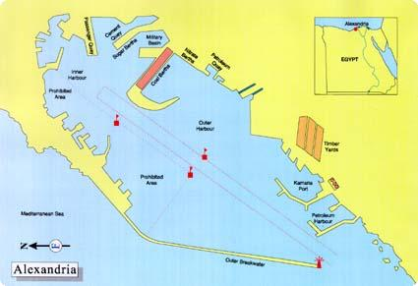
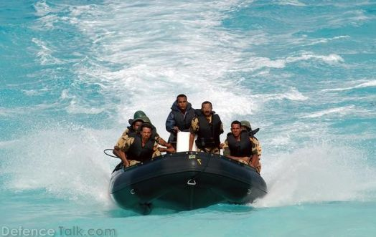
Coastal Data and Information Resources
Egyptian Naval Forces, Hydrographic Department (ENHD)
  Responsibility:
    Responsible for the production of navigation charts for Egyptian territorial waters in the Mediterranean and Red Sea.
  Data Available:
    ENHD works closely with the International Hydrographic Organization (IHO) and the International Maritime Organization (IMO).
    The department of Oceanography and Meteorology operates wave, current and tide gauges in the Red Sea and Mediterranean.

Slide 13

Coastal Data and Information Resources
Survey Research Institute (SRI)
  Responsibility:
    Adapt, develop, and incorporate modern methods of computer-aided field surveying and data processing with the aim of accelerating the production and updating different types of maps
    to serve as a central organization in developing and applying all modern aspects of geodesy; photogrammetry, remote sensing, geodesy and geographic information systems.
  Data Available:
    SRI has a monitoring program for the sea level changes along the Mediterranean and Red sea for recent years with the cooperation of marine forces.

Slide 14




Coastal Data and Information Resources
Egyptian Ports Authority (EPA)
  Responsibility:
    Management of Ports,
  Data Available:
    EPA has a monitoring program for the metrological and oceanographic parameters within the Egyptian harbors and ports

Slide 15

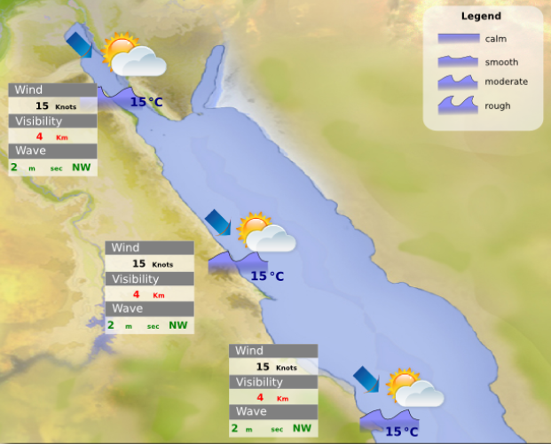
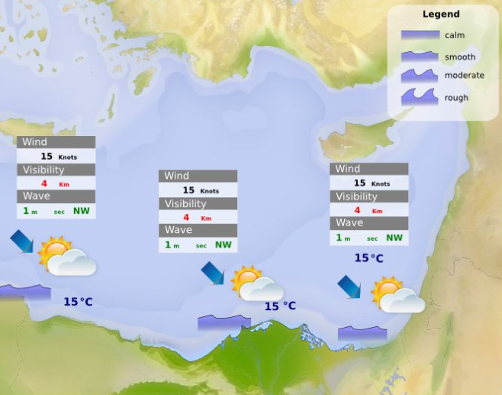
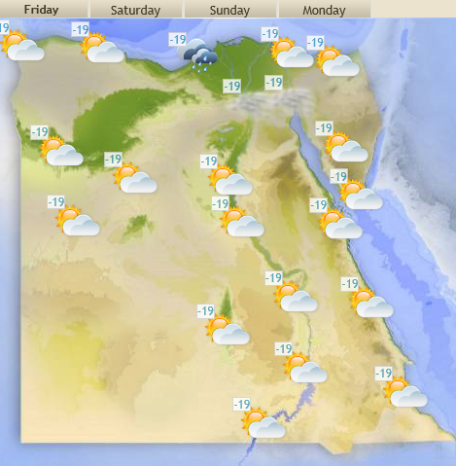
Coastal Data and Information Resources
Egyptian Metrological Authority (EMA)
  Responsibility:
    Responsible for providing the meteorological facilities and services for the Egyptian Authorities, international marine navigation and international air navigation
  Data Available:
    EMA has a large database for the metrological data.

Slide 16
Coastal Data and Information Resources
Data Exchange Challenges
  The national plan for data collection is not established yet. This situation causes many problems such as:
    Lack in data collection standardization.
    Lack in data exchange system.
    Lack in information about the available data and its sources.
    Duplication in collecting the same data which cause loss of money and time.
  To solve these problems, it is recommended to establish a Climate Data and Information Center (CDIC). The objectives of this center are:
    Acquisition, processing, quality control, inventory, archival and dissemination of data and data products
    responsible for international climate data exchange.
    Providing data and information services in real-time.

Slide 17

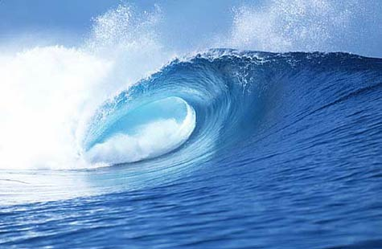
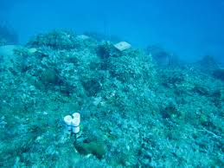
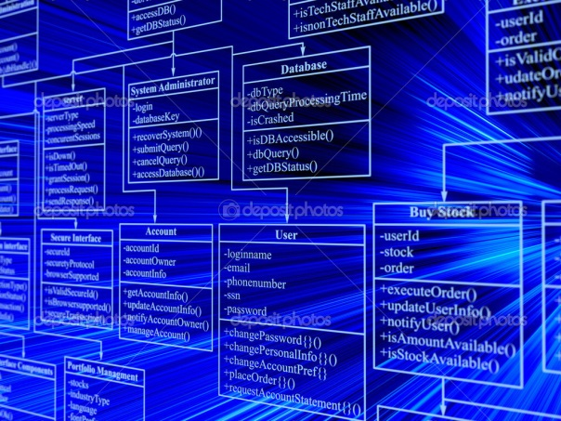
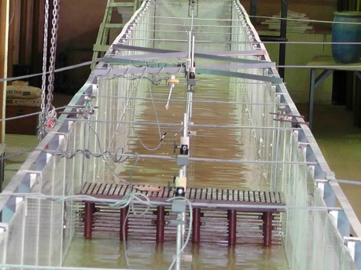
Available Facilities at Coastal Research Institute
The Coastal Research Institute hosts five well-equipped laboratories in
  Sedimentation
  Oceanography
  water quality
  physical model
  Database

Slide 18
main available equipments at Coastal Research Institute
Instrument | Description | Efficiency | Operation Cost/ Unit /Year (L.E) | Repairing Cost/ Unit | Insurance Cost/ Unit (L.E) | Units Numbers
Mari graph | Measuring sea Level | Very old and using drawing Chart | 200 | 150 | - | 6
Andera | Direct reading Current Speed and Direction | Working Good | 300 | 100 | - | 4
Current Meter (CM2, SM2) | Direct reading Current Speed and Direction | Working Good | 60 | 150 | - | 3
Wind Station | Measuring Wind Speed and Direction | Working Good | 300 | 200 | - | 2
S4DW | Measuring Wave Characteristics. | Not working and need maintain-nce | 20000 | 5000 | 20000 | 4
Wave Rider | Measuring Wave Characteristics | Not working and need maintain-nce | 20000 | 10000 | 20000 | 1
Marine System (Computer, DGPX , Echo Sounder, Outboard Motor and Rubber Boat)) | Marine Survey | Working Good | 5000 | 3000 | - | 5
Total Station | Land Survey | Working Good | 2000 | 1500 | - | 2
Precise Leveling | Measuring Land Level | Working Good | 200 | 200 | - | 5

Slide 19
Coastal Observation Instruments
In order to define Coastal Observation Instruments the following issues must be considered:
  Climate data needs are different to those data needs that support other activities of national coastal observation services.
  Its important to maintain data quality, security, homogeneity and continuity in long-term that are essential for detecting and monitoring climate change.
  The issues of data rescue and quality control are two particularly relevant issues in this regard.
  Expanding ocean and atmosphere observations scope and scale is essential to improved understanding, modeling and predicting of the ocean and climate

Slide 20
Coastal Observation Instruments
To consider such issues, the following equipments are required:
Oceanographic and Metrological data Acquisition Buoys (3 stations)
  Water Temperature
  Wave Height and Direction
  Current Speed and Direction
  Tidal Trends
  Salinity
  Turbidity and PH
  Wind Speed, Direction and Gust
  Barometric Pressure and Air Temperature.

Slide 21
Coastal Observation Instruments
Hydrographic Survey System (2 systems).
  Duel frequency Echo sounder for shallow water area, range from 0.5 to 50 m depth
  WASS and Deferential enable GPS
  Sound velocity meter
  Marine computers
  Hydrographic survey software for surveying and data analysis

Slide 22
Coastal Observation Instruments
Models
Coastal Research Institute staff developed SIMCOPRO and ImSedTran models
  Simulating coastal processes (SIMCOPRO) is a 2-D model simulating the distribution of currents, waves and sediment transport.
  Implicit sediment transport (ImSedTran) is a 2-Dmodel Simulate the distribution of the wave and determine breaking characteristic, taking into consideration the influence of existing ridges and contour line.
In addition CoRI researcher used the free One-line models GENESIS to estimate long-shore sand transport rates and long-term shoreline changes.
CoRI researchers need training on MIKE 21 2-Dimensional Wave model and Litpack main modules

Slide 23
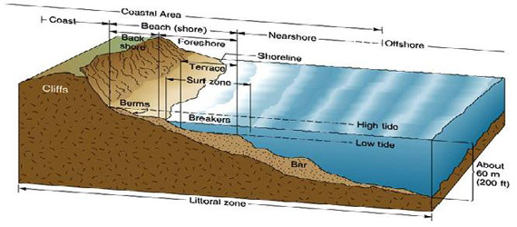
Data requirements and strategic monitoring
Observation plan is urgently needed for measuring metrological and oceanography parameters which have a great impacts on coastal zone.
Inshore zone:
  Periodic land survey of hydrographic profiles distributed along the study area two times per year.
  Recording wind speed and direction.

Slide 24
Data requirements and strategic monitoring
Near shore zone:
  Periodic survey of hydrographic profiles distributed along the study area two times per year.
  Recording the variation of sea level.
  Daily measurements of long-shore current in the critical areas.
  Measuring current beyond breaker zone, two times per year.
  Measuring current in the outlets of the lakes (daily).
  Collecting surface bottom samples from the seabed, two times per year.
  Measuring temperature, salinity, two times per year.

Slide 25
Data requirements and strategic monitoring
Offshore zone:
  • Recording wave height, period and direction.
  • Recording current speed and direction.
  • Recording weather parameters: air temperature, wind speed & direction, …etc.

Slide 26
Continuous observation would provide:
Bathymetric surveys
Topographic surveys
Aerial surveys
Lidar surveys
Ecological mapping
Hydrodynamic data collection
Analytical services

Slide 27
Way forward
Main problems are:
No data and information exchange
Insufficient budgets and funds
Capacities
No Coordination
No Cooperation
No Integration
The main questions are:
Who makes what, How, Where & for how long…?
Where are the gabs (types, locations, frequencies, analysis)?
Who would take the lead to initiate coordination that results in cooperation that reaches the integration?

Slide 28
Thanks to You All

